Slide 1

Battle of the Neighborhoods
Prime Restaurant Locations in Los Angeles, CA

Slide 2
The Problem
1. Introduction to the Business Problem
An eager new chef is looking to establish himself in the Los Angeles culinary scene, but he is not sure which location will be the most successful. Los Angeles has numerous locations with a robust restaurant scene, but data analysis is necessary to chose the correct location. Ensuring the right location could be make it or break it for this this chef and several factors will be considered in the location hunt. According to The Balance Small Business website, there are several pertinent decision making factors.
Visibility - Setting up in a high foot traffic area.
Size - How big or small is the restaurant going to be.
Neighborhood - This is two pronged, in that who else has a restaurant space as well as the crime statistics in the area.
Affordability - The cost of the lot.
Competitor Analysis - This goes hand in hand with Neighborhood but is important in it's own right.
In this project, we will use data from the Foursqaure API to address the aforementioned data points.
2. Data
We will attempt to address all the factors above, but will likely be limited to lack of availability of some data sets. The most important factors, and the ones we will work with will be Visibility, and Crime Rates. Competitor analysis will be inherent within the project.
Datasets:
Los Angeles Crime data from 2020 to Present - This dataset reflects incidents of crime in the City of Los Angeles dating back to 2020. This data is transcribed from original crime reports that are typed on paper and therefore there may be some inaccuracies within the data. Link
Los Angeles Neighborhoods - Official Certified Neighborhood Council boundaries in the City of Los Angeles created and maintained by the Bureau of Engineering / GIS Mapping Division. Link
Building Permits by Neighborhood - Link
Search Engines:
Foursqaure. We will use the foursquare API to carry out venue and point of interest search. The results will give us an idea of the neighborhood of the venue's potential location.
3. Methodology
For this project, we will explore Los Angeles Neighborhood and Crime data with the intent to answer the critical factors discussed in the intro. Following that, utilization of the Foursquare API will allow us to explore data within our neighborhoods, providing information on venues and other types of restaurants. The neighborhoods will be clustered using the k-mean algorithm. The culminating results will provide potential restaurant locations for our entrepreneurial chef.

Slide 3
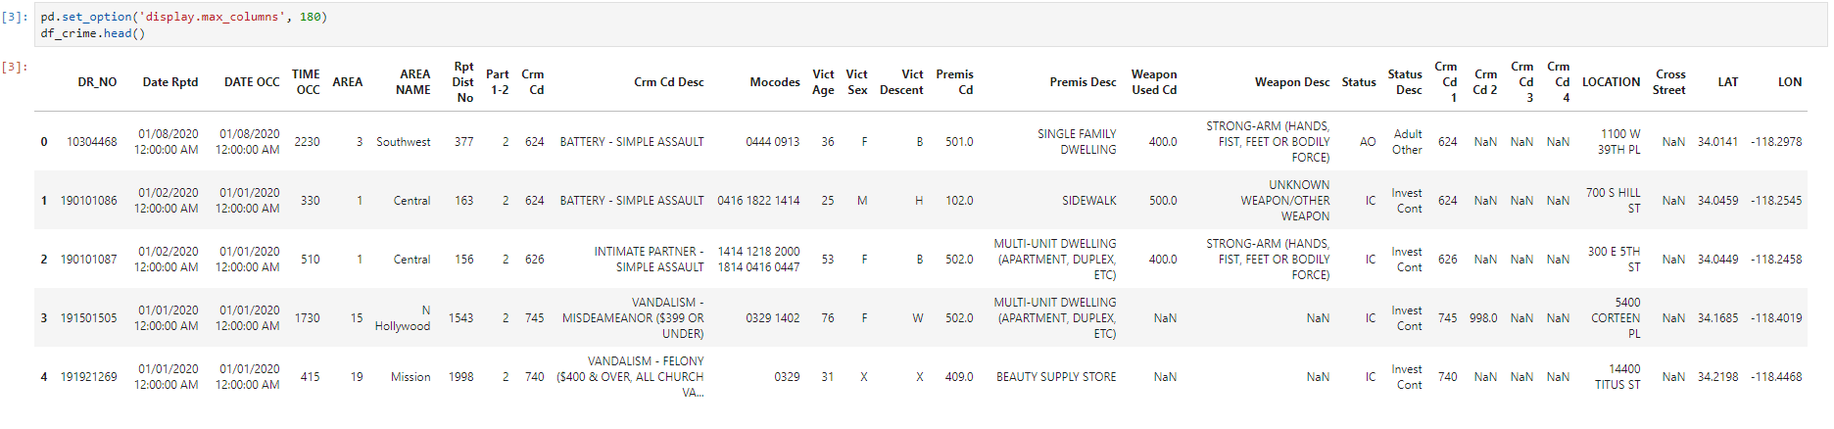
The Data
We started with crime rate. This noted reported incidents from the start of 2020 to present day.

Slide 4
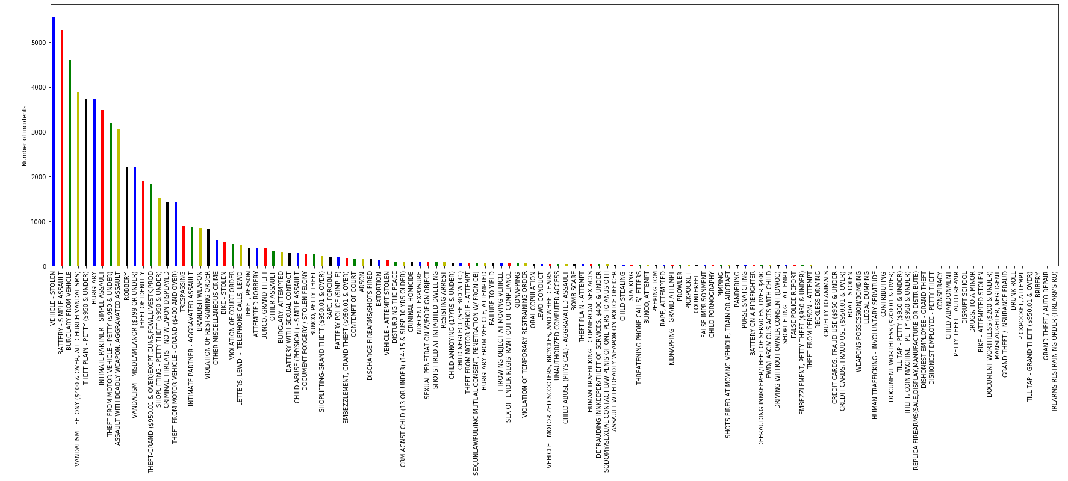
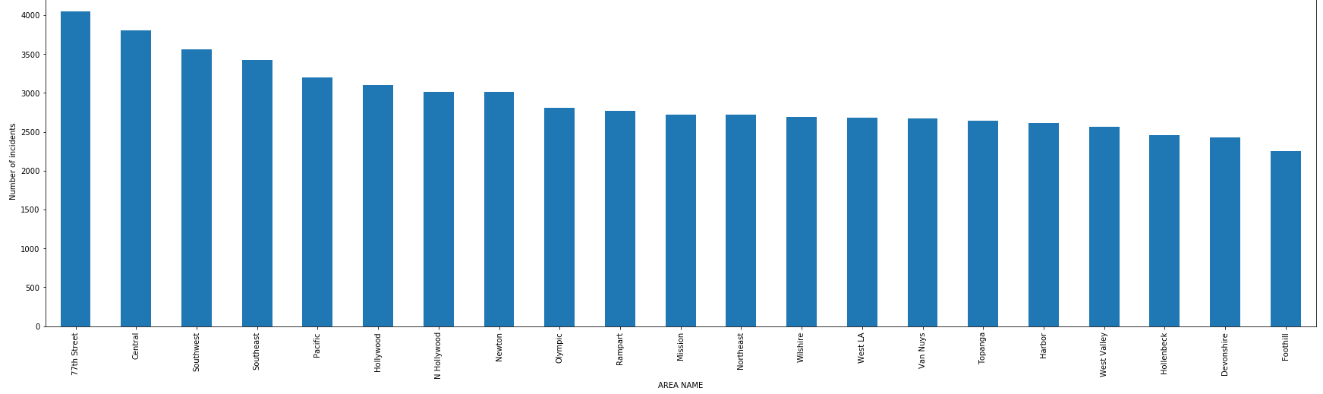
Plots
There were several notable columns, but we opted to use But for our purpose, we only need ‘Crime Description,’ ‘Area location,’ ‘Latitude,’ and ‘Longitude.’ We dropped unwanted columns and cleaning up NaNs, the number of crimes can be plotted by categories:
Now for the distribution.. We took advantage of ‘Area Name’ Using the value_counts function, the total number of incidents grouped by Area is plotted as follows:
1.
The highest reported crime is Vehicle-Stolen, Battery-Simple Assault, followed by Burglary From Vehicle.
2.
Crime is prevalent across most the areas in lA, with the 77th Street Area having the highest reported data followed by Central.

Slide 5
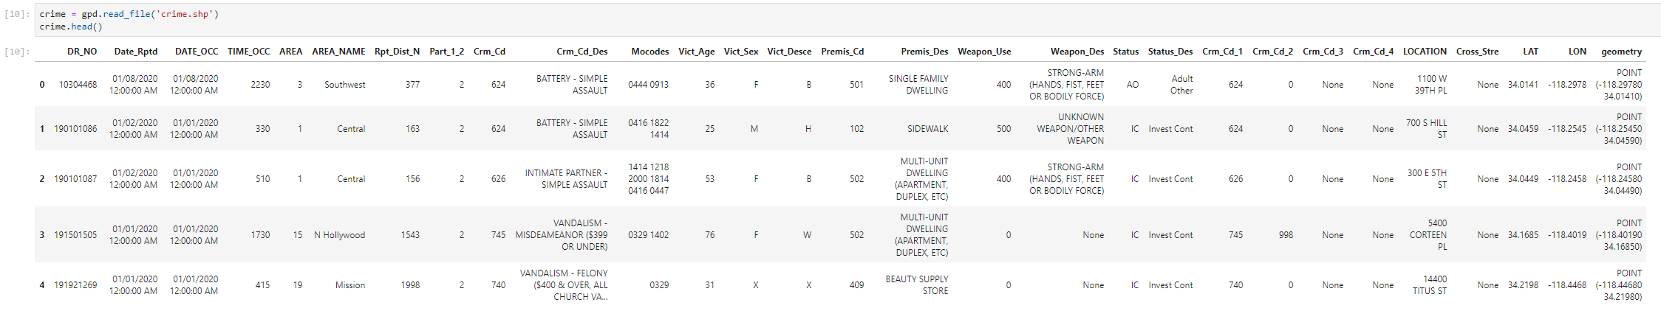
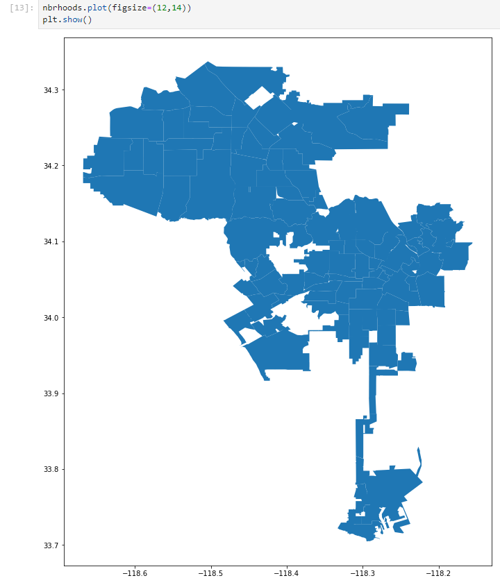
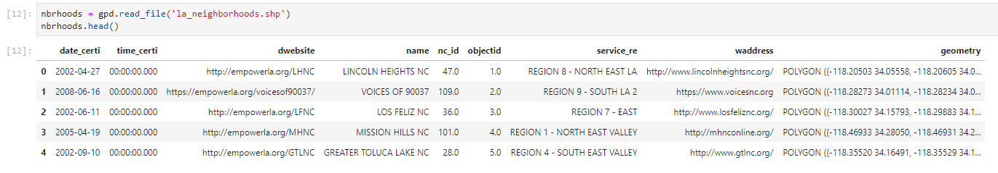
Locational Data
We needed to compare the data visually, this was done by combining ‘Latitude’ and ‘Longitude’ columns to form a GeoDataFrame.
We also plotted the neighborhood data. Which will later be combined.

Slide 6
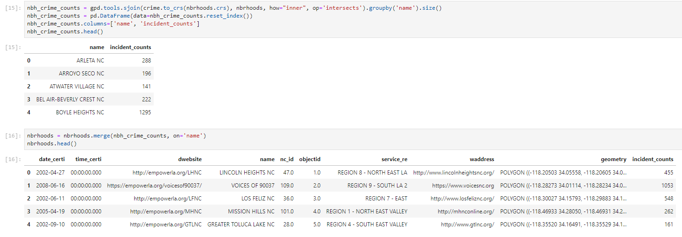
Spatial Join
The crime numbers for each neighborhood were aggregregated with an op=intersects parameter within the Pandas sjoin function.

Slide 7
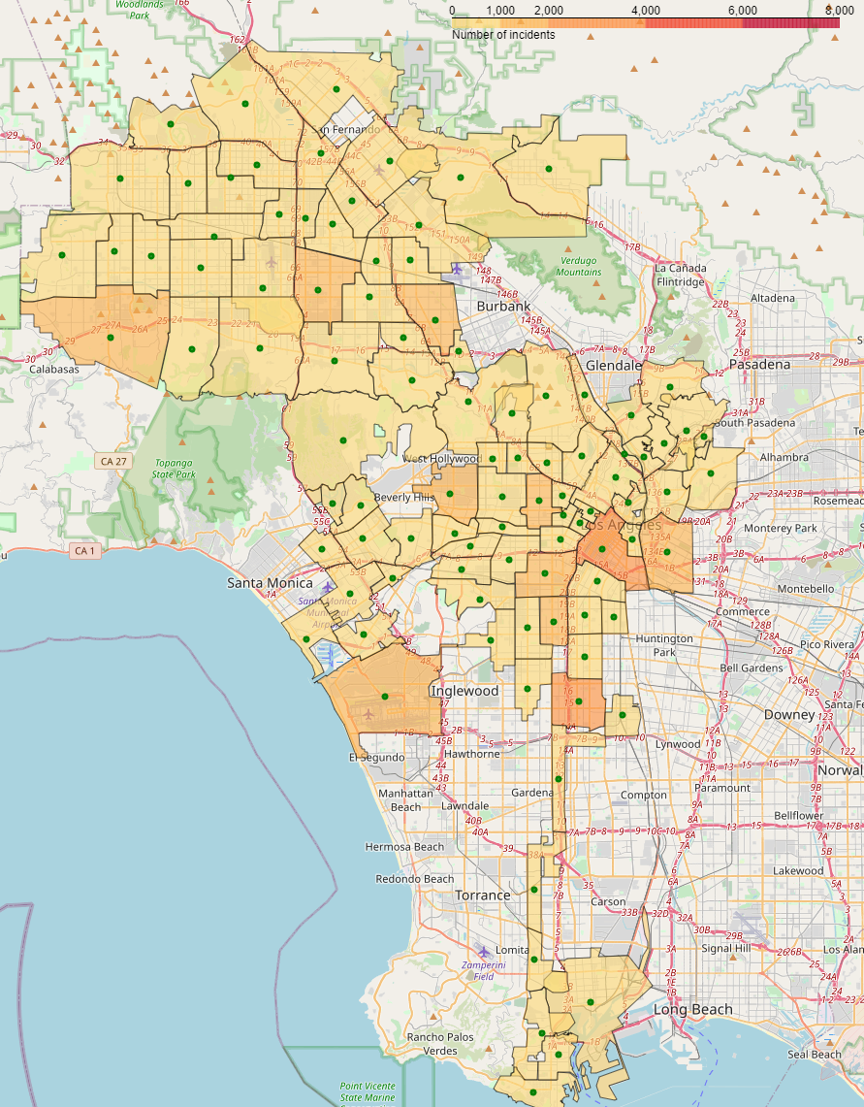
Crime Map
A choropleth map created using Folium. This contains geospatial and statistical data.

Slide 8
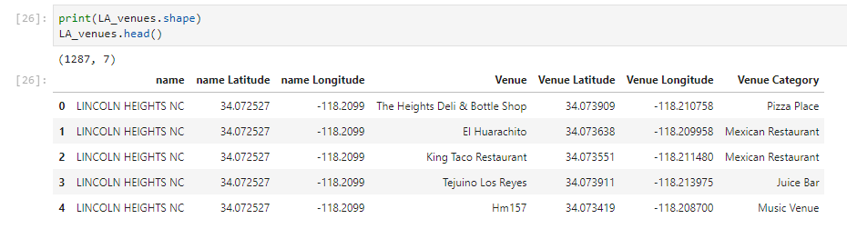
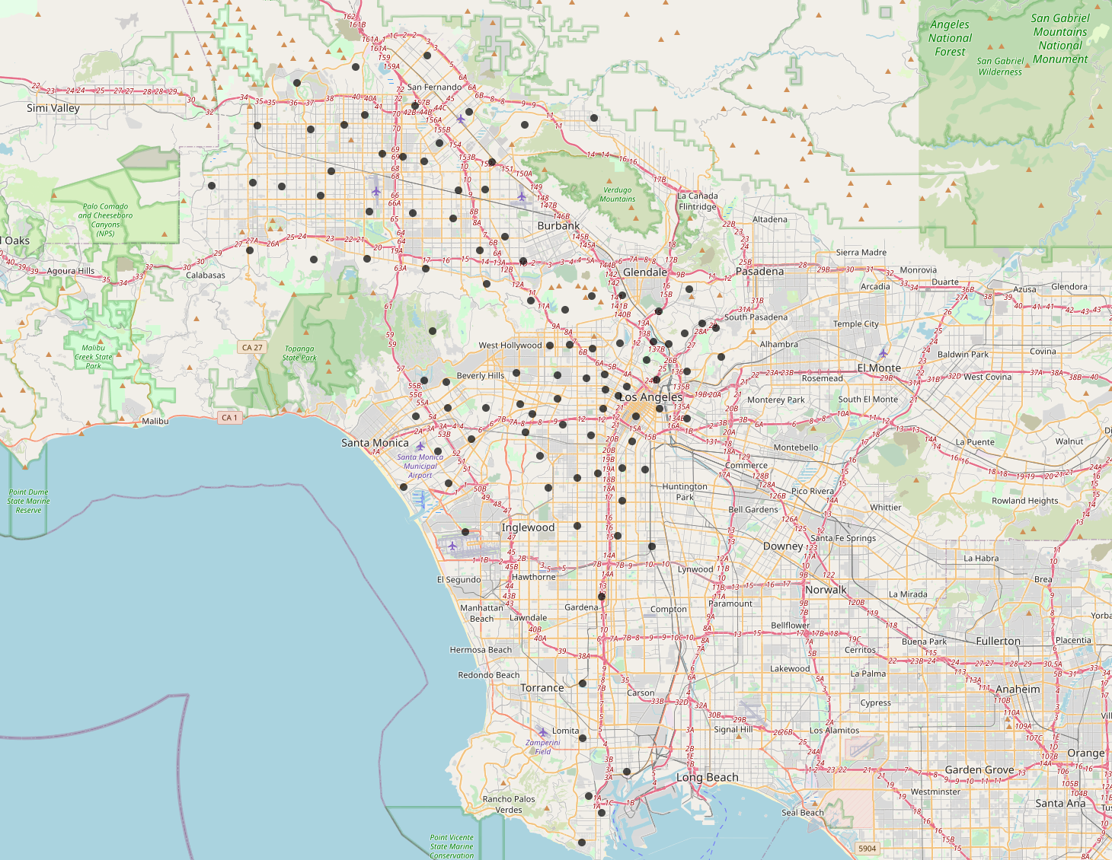
Venue Data
Using the Foursqare API we queried for the top ten most common venue for each neighborhood.
Following that, we plotted the clusters using the k-means algorithm and a representative_point() function from GeoPandas to extract a location that is located in the specific neighborhood

Slide 9
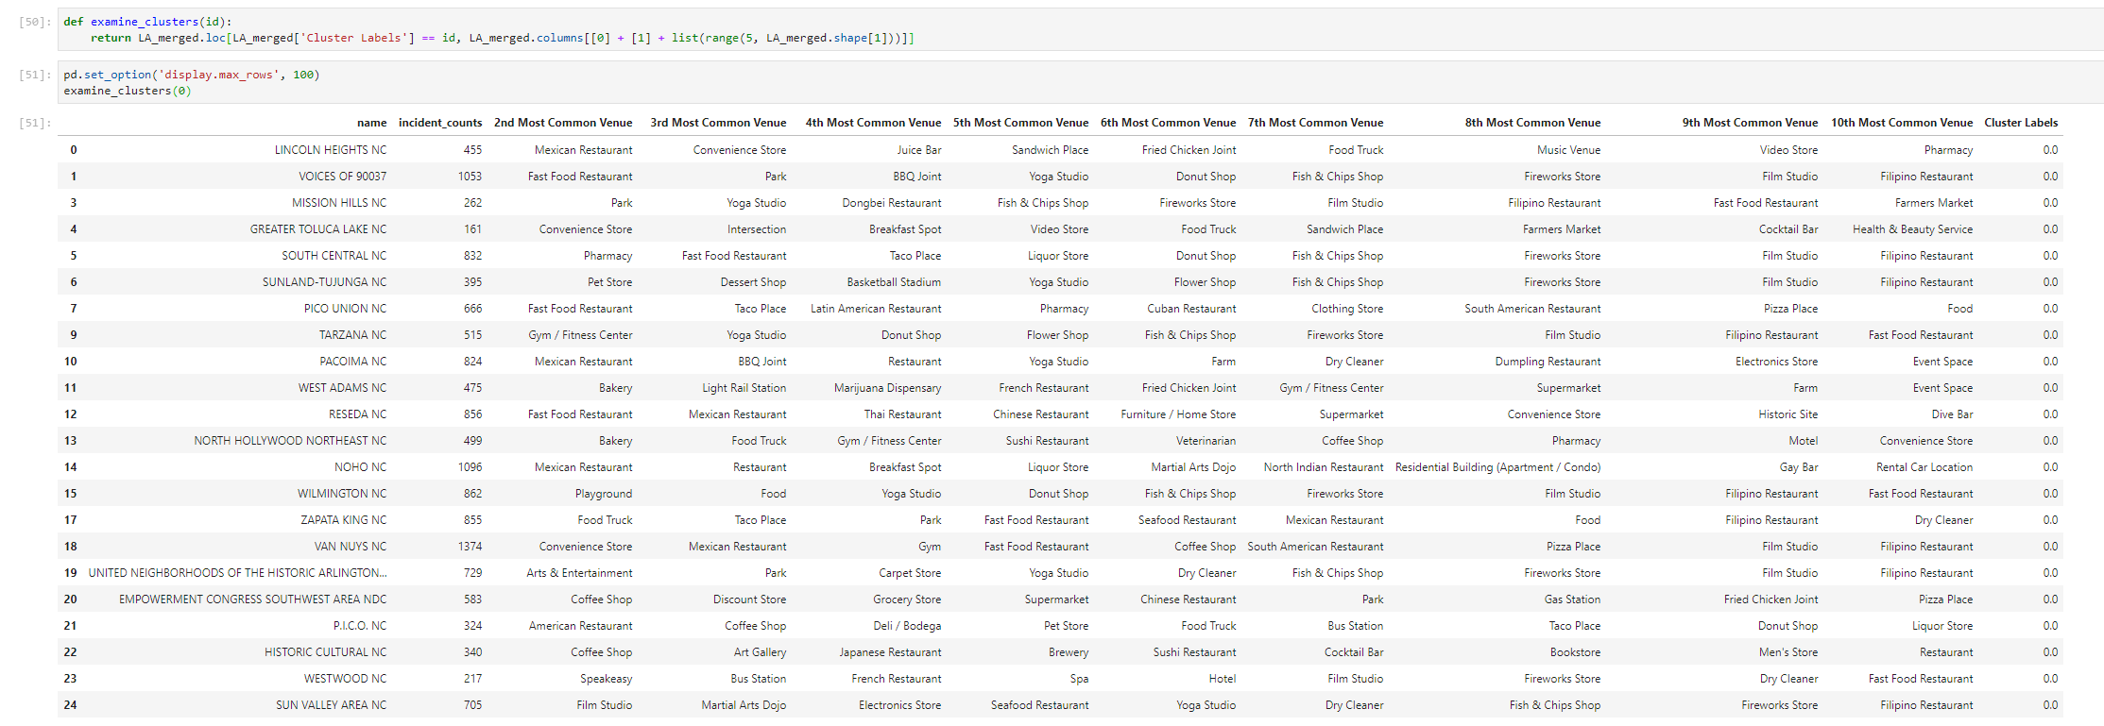
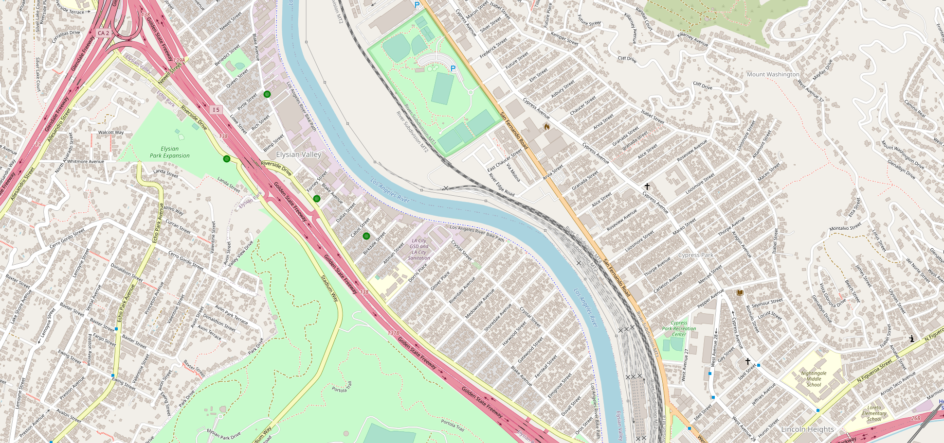
Examine Clusters
By analyzing public datasets obtained from the LA City data portal, we identified Elysian Valley as a possible neighborhood that is ideal for opening a new restaurant. We relied on aggregating crime data for neighborhoods in and around Los Angeles. With the help from the Foursquare API, we further demonstrated that Elysian Valley is a suitable candidate by highlighting a list of already successful restaurants. In addition, we determined that the proximity to Dodger Stadium would ultimately boost revenue due to increased foot traffic before and after sporting events. Lastly, while we have identified an ideal neighborhood, going forward we would like to identify additional information on our competitors and deeper demographic
information on our proposed area.
1. Visibility: Our results reveal that Elysian Valley should receive notable foot traffic as well as commuter traffic. This is due to the proximity of the Golden State Freeway (I5), the large nearby park, and Dodger Stadium. Blake AVenue would likely serve as the best location to buy a property. Further analysis on the pricing/availability on this street is needed to pinpoint a precise lot.
2. Competitor analysis: In the above sections, we very listed the categories of venues in Elysian Valley. This list provides an excellent overview of our competitors. It also guides us in determining which category we should be focusing on or avoiding. An improvement would be to cluster the restaurant categories. The results could let us know the landscape of the restaurant business in this neighborhood.
In this capstone project we identified an eager new chef who was looking to establish himself in the Los Angeles culinary scene, but he was not sure which location will be the most successful. Los Angeles has numerous locations with a robust restaurant scene, but data analysis is necessary to choose the correct location. Ensuring the right location could be make it or break it for this this chef and several factors will be considered in the location hunt. We identified the most important factors that could impact the choice. Using crime and neighborhood datasets, located a possible neighborhood that has a relatively low crime rate and prime location. The Foursquare API recommendation results also seem to support our pick.

